Slide 1

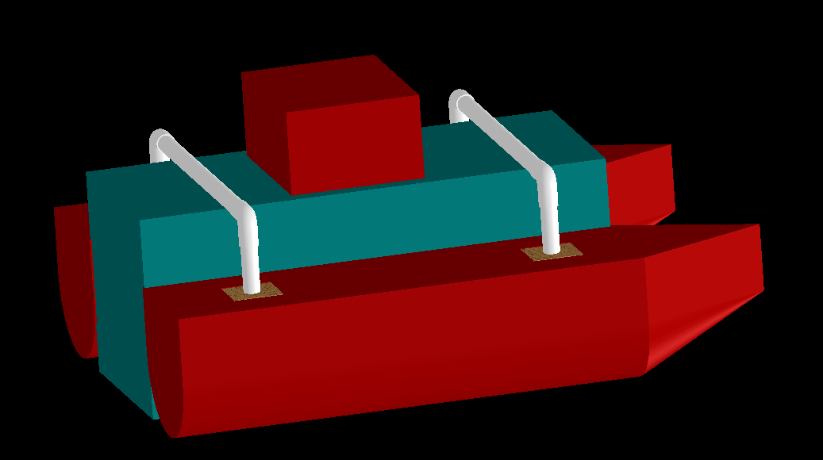
AI-Bot
5m Radius Covered by Intelligent Camera.
Application of Machine learning.
Can Collect up to 45 Bottles.
Battery Fully charged within 2-3 hours.
Fully Electronic
Autonomous Intelligent
Bottle Obtaining Tool
Worlds First
Intelligent Plastic Clearing Vessel
Presented by:
Hafeez T. Shittu Mohsin Mehmood

